Slide 1
Structure changes everything
The fresh & light slide template
April 2026
Firstname Lastname
Title/Role

Slide 2
Today’s agenda
01
The problem with content at scale: Why most orgs hit the same wall
02
Composable content fundamentals
03
Three patterns in the wild: Real examples from enterprise teams
04
How to get buy-in and get started: Building your case for change
05
Q&A

Slide 3
WHAT SETS US APART:
Not just a CMS — a content infrastructure platform.
Content federation
Composable delivery
Enterprise governance
Connect any CMS, database, or API. Normalise content into one schema without migration or downtime.
One GraphQL endpoint delivers content to web, mobile, apps, and any digital surface, all from the same model.
Role-based access, approval workflows, locale management, and full audit logging built in.

Slide 4
How to get there: 5 steps to composable content migration
1
2
3
4
5
Audit your current state
Define your content model
Choose your foundation
Run a pilot
Scale & govern
Map all content systems, owners, and touchpoints. Find the duplication and the gaps.
Design a unified schema. Start simple — model what you have before adding what you want.
Select a headless CMS that supports federation. Hygraph is built for this from day one.
Pick one market or content type. Prove the model works before scaling to the full org.
Roll out to all teams. Set role permissions, approval flows, and content standards org-wide.

Slide 5

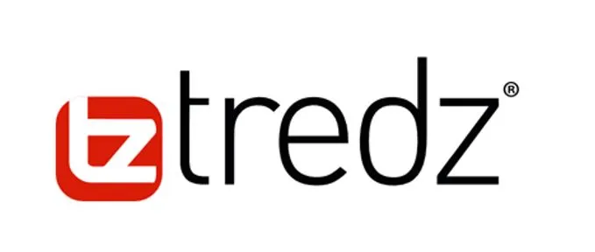
“
The developers love Hygraph and the speed of implementation it has given us. We got our checkout, a new product comparison feature, and our brand-new product page live within less than a month!”
Andrew Rees
Head of Development and Technology
Notes:
Halfords and its subsidiary Tredz Bikes, [LON: HFD], UK’s largest bicycle retailer that trusts Hygraph with their large e-commerce product catalogue. Leveraging Hygraphs Remote sources for editors to fetch product information from anywhere:

Slide 6
OUR STRATEGIC DIRECTION
We're focused on scaling efficiently while maintaining the quality and customer obsession that define us. This quarter marks a turning point where we transition from building product to building platform infrastructure that enables others to build on top of our foundation.
Our three pillars moving forward are:
Reliable infrastructure
Seamless developer experience
Community-first mindset
Each team plays a critical role in delivering against these priorities.

Slide 7
Speed is just the start. Hygraph drives outcomes.
+136%
+57%
+15%
eCommerce conversion rate
higher interaction sessions
customer engagement rate
Sennheiser
Dr. Oetker
Samsung
+20%
+15%
27
higher web monetisation
increase in online revenue
countries replatformed in one go
Autoweb
Stobag
Lindex Group

Slide 8
THE PROBLEM
Three forces that are making content harder every year
01
02
03
Proliferating channels
Organisational sprawl
Legacy system debt
Web, mobile, in-store, voice, AR. Each new surface demands its own content pipeline, straining teams built for one-channel publishing.
Global teams, agency partners, and specialist contributors working in disconnected tools, creating version hell and brand drift.
Monolithic CMSs that were never designed for API delivery, forcing expensive migrations every 3-5 years as business needs evolve.

Slide 9
One platform. Two superpowers. No siloes.
For editors
For developers
Visual content modelling
Scheduling & publishing workflows
Field-level localisation
AI Assist for content generation
Reusable components & variants
No developer needed for daily tasks
GraphQL & REST APIs out of the box
SDKs and CLI tooling
Webhooks & event-driven architecture
Multi-environment support
Composable, schema-driven models
Integrates with any frontend stack

Slide 10
Platform capabilities: Built for how enterprise teams actually work
01
02
03
04
Federated CMS
API first delivery
Global scale
Role-based workflows
Unite content from any source — headless, legacy, or third-party — into one coherent content layer.
Built on distributed infrastructure. Sub-100ms content delivery anywhere in the world.
GraphQL and REST APIs out of the box. Deliver to any frontend, app, or device with no re-architecture.
Custom approval chains, contributor roles, and publish controls built for distributed teams.

Slide 11









Extend with the Hygraph Ecosystem
The Hygraph Marketplace
A network of support
6000+
2.2B
99.9%+
Developer community
Monthly content entries
Uptime
Active members in
Hygraph's Slack community
Served globally with
high performance
Proven reliability for
enterprise needs

Slide 12
BEFORE HYGRAPH
WITH HYGRAPH
Content everywhere.
Control nowhere.
One layer.
Total clarity.
14 separate CMSs across regions
Content duplicated and out of sync
3-week publish cycles
Dev team blocked on every update
Single federated content layer
Real-time sync across all markets
2-day publish cycles
Dev team ships new touchpoints, not fixes

Slide 13
Q2 Results
REVENUE GROWTH
NEW CUSTOMERS
PRODUCT ADOPTION
23%
17
91
increase YoY
enterprise accounts
features used

Slide 14
OUR POSITION
Content infrastructure
for the next decade.
Most CMS platforms were designed for a world where content lived in one place, rendered in one format, and reached one type of audience. That world is gone.
Hygraph was built for what's next — a federated model where content from any source can be composed, governed, and delivered anywhere, without re-platforming every time the business evolves.
One platform. Every touchpoint. No compromise.

Slide 15
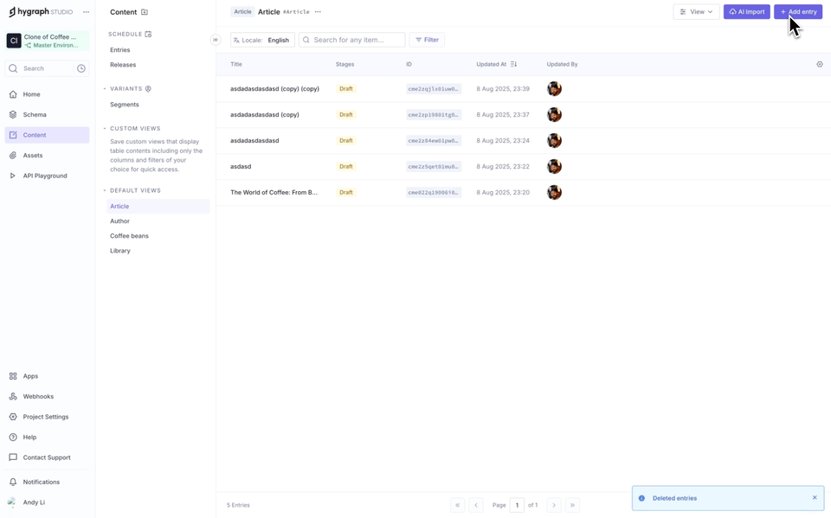
Deliver personalization without slowing down your editors
Variants Sept 2025 GA
Personalize without the manual work
Create, search, and manage content variations for each audience segment natively in your CMS
Optimize visuals for each context
Auto-resize, crop, and format images so they fit every channel and convert better
Reduce editorial overhead with AI
Generate, review, and manage content variations directly in the CMS optionally with AI Assist
Create once, update everywhere
Maintain consistency and cut down time with reusable content components
Notes:
Talk Track:
Personalization should not slow anyone down.
With Hygraph, editors can create, search, and manage variations for each audience segment directly inside the CMS, without jumping between tools - just like the way shown on the animation on the left.
Visuals are automatically optimized for each context. Images can be resized, cropped, and formatted so they fit every channel and convert better.
AI Assist can generate, review, and manage variations inside the CMS, reducing repetitive work and freeing time for higher-value tasks.
Reusable components mean you create content once and update it everywhere, keeping consistency while cutting down production time.
It is personalization that works at the same speed as your business.
Features highlighted:
Hygraph AI Assist
Reusable components & content as atomic pieces
Taxonomies & relations between pieces
Variants
Asset Management

